Slide 1
Great Theorem: Heron & Formula for Triangular Area
Heron
Journey Through Genius Pp 117

Slide 2
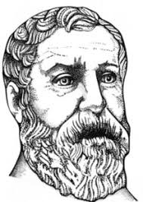
Heron
The final classical mathematician, sometimes called Hero
Very little is known on the personal life of Heron, although there is an astounding amount regarding his mathematics
He kept his interests very practical: mechanics, engineering, measurement
His interests highlighted the difference in Greek and Roman mathematics
His great theorem certainly had practical intent, but his argument shows his strengths in abstract geometry

Slide 3
The Great Theorem: formula for finding the area of a triangle

Slide 4

Notes on the Great Theorem
This may seem trivial, given the simplicity of the modern formula, but this specific formula is used when the side measurements are given, and not necessarily the height
Given the SSS congruence, any other triangle with the same side measurements is inherently congruent, and therefore has the same area as the aforementioned triangle -- so given the three sides, there is one and only one possible value for area
The formula he derived is as such,

Slide 5
Preliminaries
Heron’s argument relied on five preliminaries
The bisectors of the angle of a triangle meet at a point that is center of the triangle’s inscribed circle (Elements, IV.4)
In a right triangle, if a perpendicular is drawn from the right angle to the base, the triangles on each side are similar to the whole and to one another (Elements, VI.8)
In a right triangle, the midpoint of the hypotenuse is equidistant from the three vertices *
If AHBO is a quadrilateral with diagonals AB and OH, and if ∠HAB and ∠HOB are right angles, then a circle can be drawn passing through the vertices A, O, B, H *
The opposite angles of a cyclic** quadrilateral sum to two right angles (Elements, III.22)
* prove this ** cyclic polygon: a polygon in which a circle can be circumscribed about the polygon through each vertices

Slide 6
We known the final result, let us examine Heron’s argument in three parts.

Slide 7
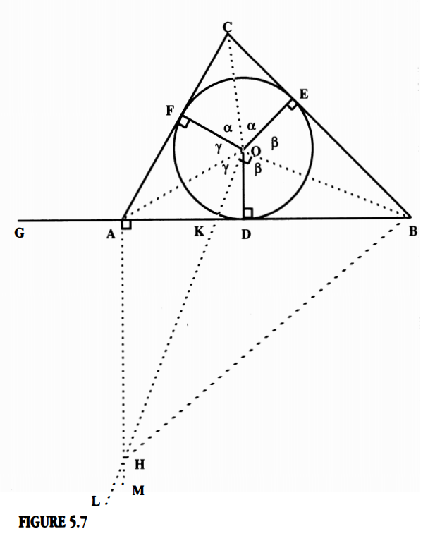
Part A: begin be inscribing a circle in a triangle ABC (uses preliminary 1)
Part B: Established triangle congruences with ABC (uses Elements, I.26)
Part C: Examine quadrilateral produced by the figure (uses preliminaries 4, 5, 2)

Slide 8
Thus ends one of the cleverest proofs of elementary algebra. Certainly the most convoluted we have encountered. Throughout the argument, Heron has a way of making us think we are reaching a conclusion, then turning a corner to keep us on our toes.

